Slide 1

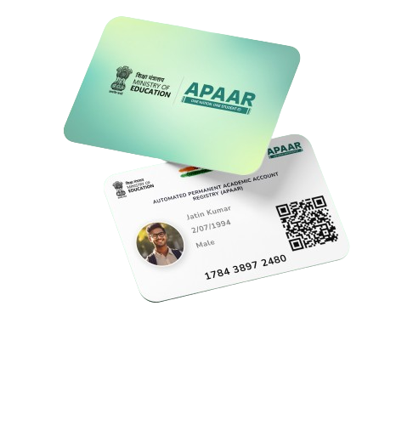
Automated Permanent Academic Account Registry (APAAR) ID
Implementation at Population Scale

Slide 2

    Automated Permanent Academic Account Registry (APAAR ID)
Introduced in alignment with NEP and NDEAR.
12 Digital AADHAAR linked lifelong learning ID for students.
25 Cr provisional IDs created for school students.
Launched on 13th February 2024.
100 Days Campaign to link APAAR with AADHAR.

Slide 3
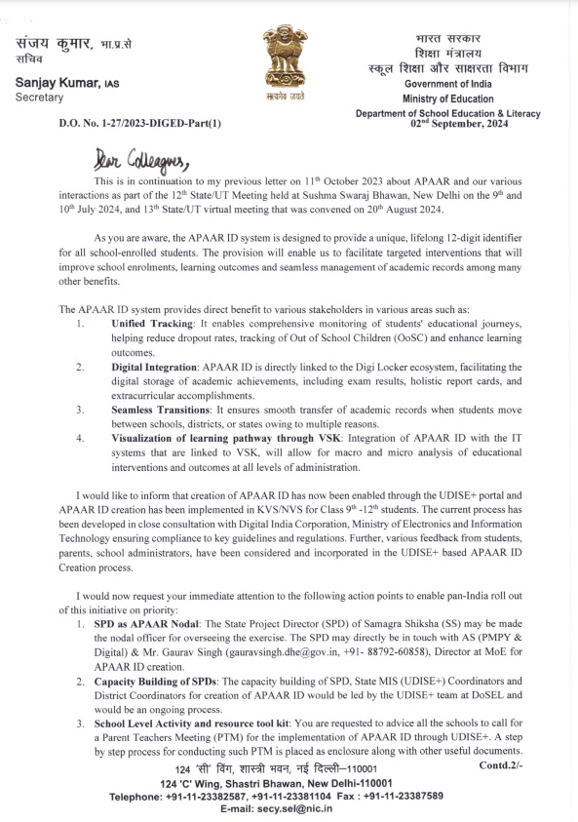
APAAR – An Overview
13th February 2024
27th June 2024
02nd September 2024
APAAR was launched by Hon. Minister of Education Shri. Dharmendra Pradhan
Technical Readiness of UDISE+, DigiLocker API developed and tested for APAAR ID Generation
Launch of APAAR ID Generation Campaign at School Level – Secretary, School Education Letter
1
2
3
4
5
03rd June 2024
06th August 2024
Meeting convened by Hon. Secretary to initiate 100-day plan for APAAR along with DoSE&L, CSC, NeGD & DIC and UDISE+ was decided as the end-to-end platform
Close group pilot conducted for APAAR ID Generation and feedback incorporated in the process.

Slide 4
Key Decisions taken for APAAR ID Generation
UDISE+ as an end-to-end platform for APAAR ID Generation
Legally vetted multilingual consent forms is being utilized as per provisions of AADHAAR act.
A confirmation SMS will be delivered to the parents through their registered mobile number updated in UDISE+
Physical presence of parents are required while submitting consent forms at schools
IVRS Facility has been set up by NeGD for assisting schools & parents with APAAR ID Generation

Slide 5
Key Decisions taken for APAAR ID Generation
Validation of student's details (Name, DOB etc.) as per AADHAAR Card
UDISE+ will provide the MIS Report on APAAR ID Creation and Verification
Important academic documents (under identification) to be made available on DigiLocker
RTE, SSA entitlements and other benefits are to be linked to APAAR.
All IT Systems in the state linked to the VSK need to be APAAR Seeded
Ensure printing of APAAR ID in all Student ID Cards and other documents

Slide 6






Roll Out Strategy
MEGA PTMs Called by School
Session on APAAR– benefits and long-term uses, Q&A session
Parent consent (Physical) collected in presence of school administration
Activities during school PTM
Stored to UDISE+
APAAR ID created
Verification of Consent Form with AADAAR Details
School Login to UDISE+ Portal > APAAR Module
Activities of UDISE Coordinator after PTM
INTEGRATED TO DIGILOCKER
School ID Cards to Print APAAR ID #
Confirmation SMS delivered to parents UDISE+ registered mobile number

Slide 7
Steps to be taken by State – Phase 1: Readiness (Day 1-15)
Appoint State MIS Coordinators as Asst. Nodal Officers for APAAR Creation
  Sent confirmation letter to Secretary, School Education with details of the Asst. Nodal Officer.
Appoint DEO as District Nodal Officer
  DEO to submit a district wise plan for APAAR Roll out with timelines.
Access, utilize and circulate IEC Materials for APAAR Campaigns
  Resources are available at APAAR Website.
  Multi-lingual contents are available. States may create more on need basis.
  Posters may be printed and sent to all schools.
1
2
3

Slide 8
Steps to be taken by State – Phase 1: Readiness (Day 1-15)
Conduct Capacity Building Sessions for School UDISE+ Coordinators, HMs, Teacher
Asst. Nodal officer and DEOs to conduct handholding for schools.
Conduct online and offline trainings.
Roll-out at Schools
  Call for PTM for Class 9th – 12th in a phased manner
  Inform about APAAR, help clarify doubts.
  Print student id card with APAAR number
Ensure Monitoring and Evaluation
  VSKs may be leveraged to map the implementation of APAAR at Block, District and State level.
  Seed the generated APAAR ID to State MIS Portals.
4
5
6

Slide 9

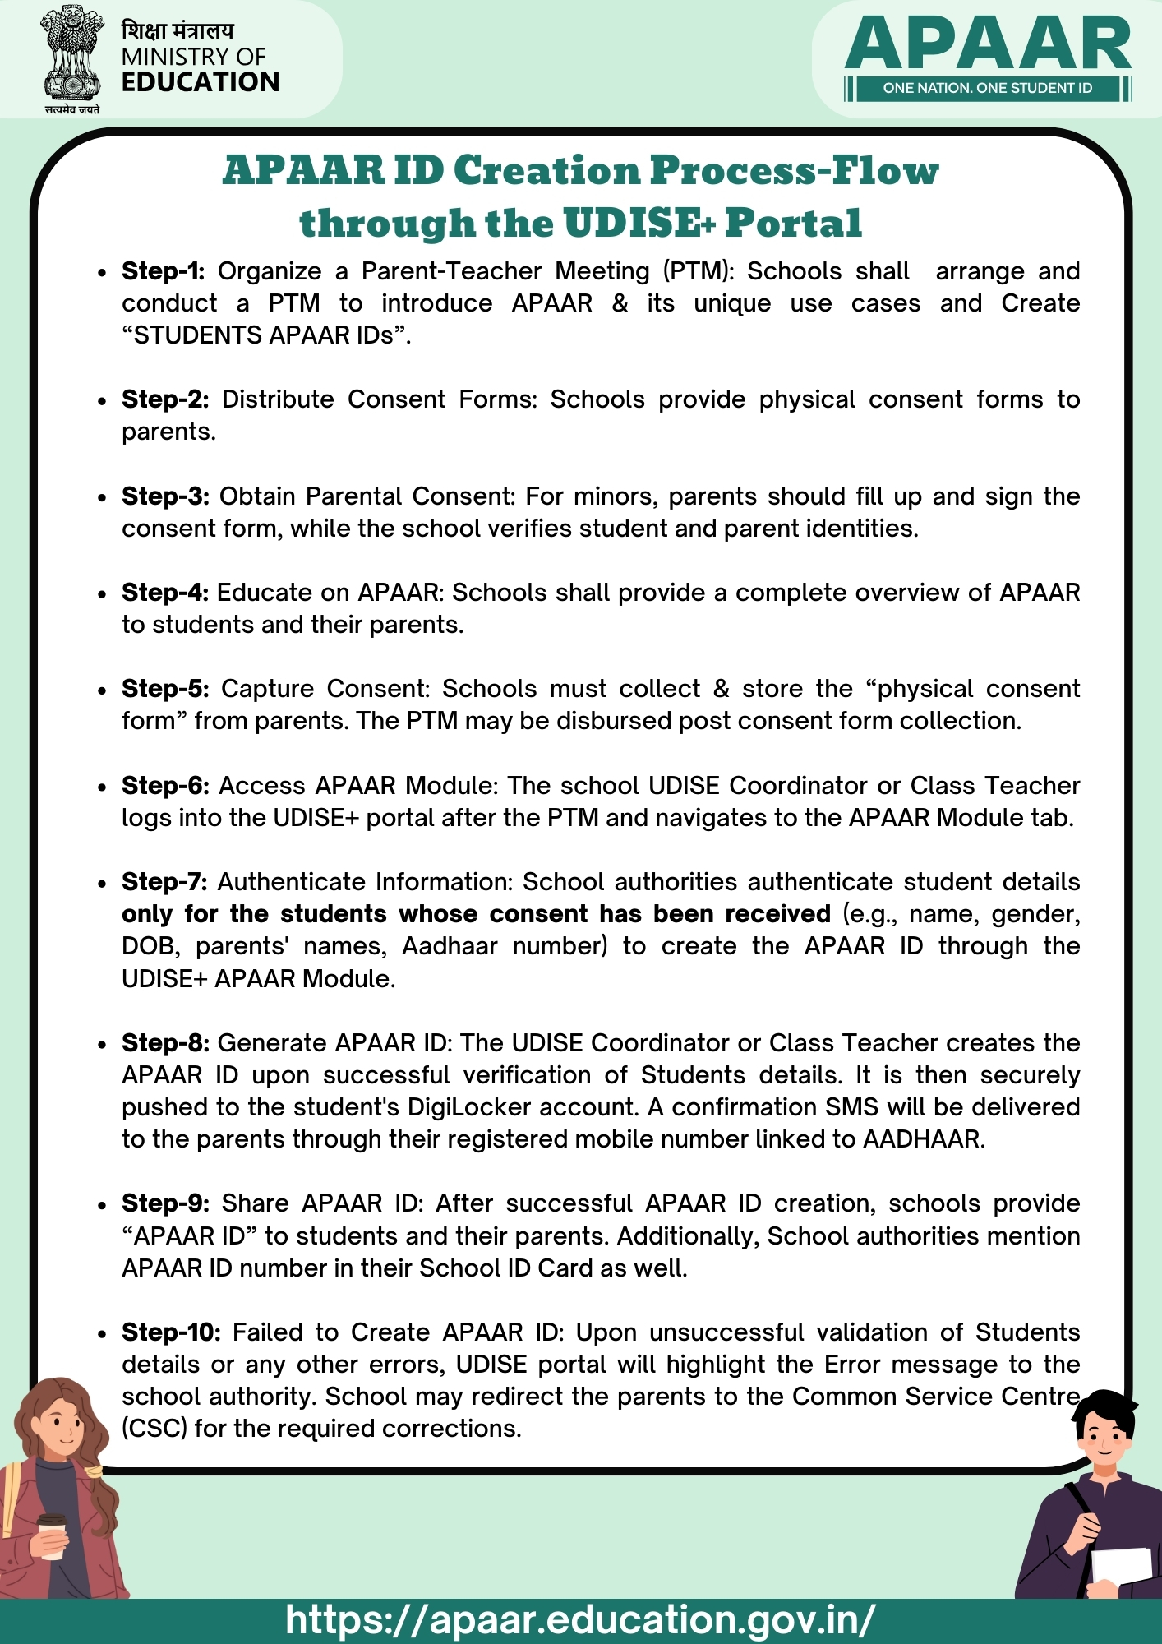
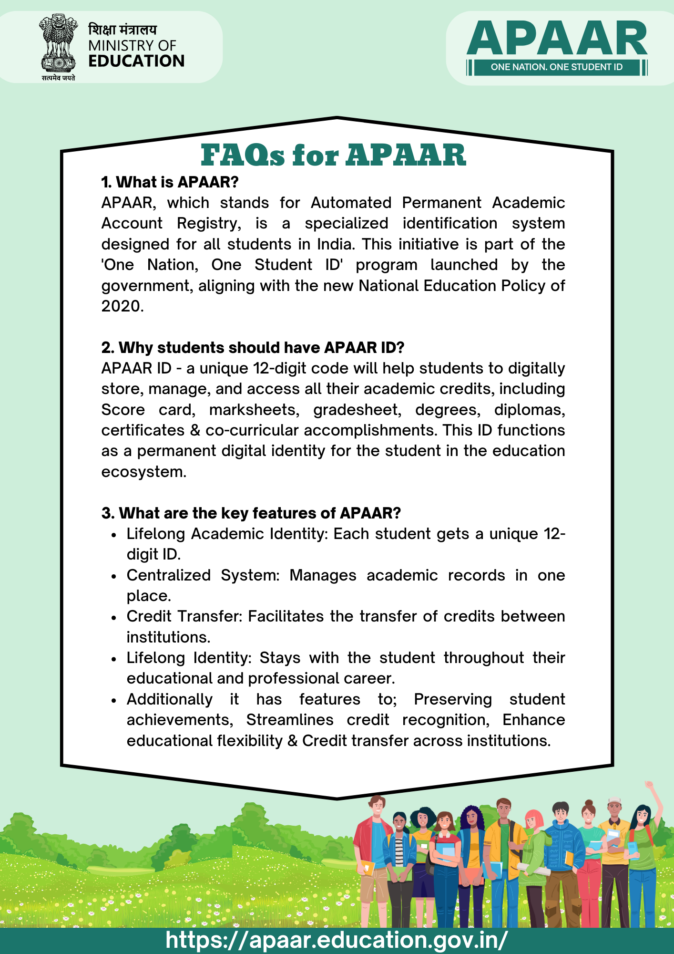

Support and Next Steps
APAAR Helpline Number: 1800-889-3511
For Any Support in verification of APAAR:
1.
2.
For more information:
https://apaar.education.gov.in/resource
Step-By-Step Creation Process Flow
Detailed FAQ on APAAR ID Creation

Slide 10
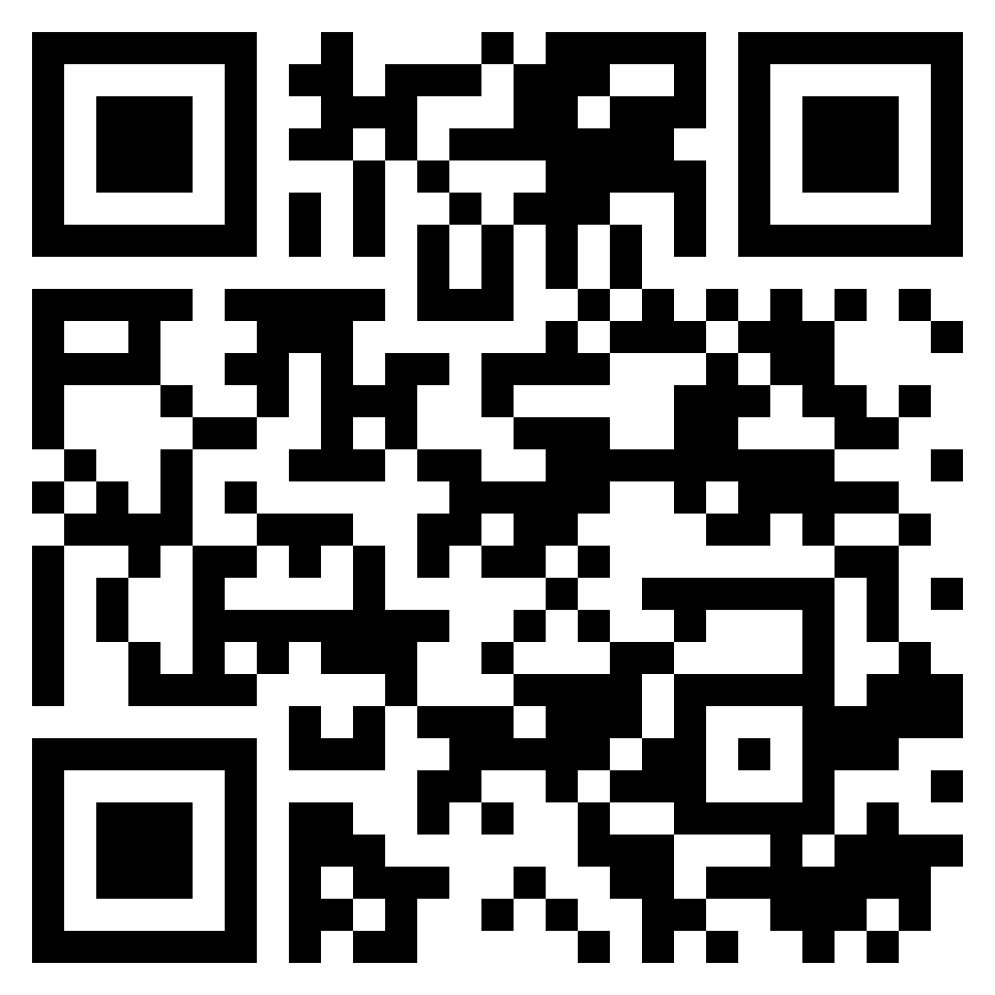
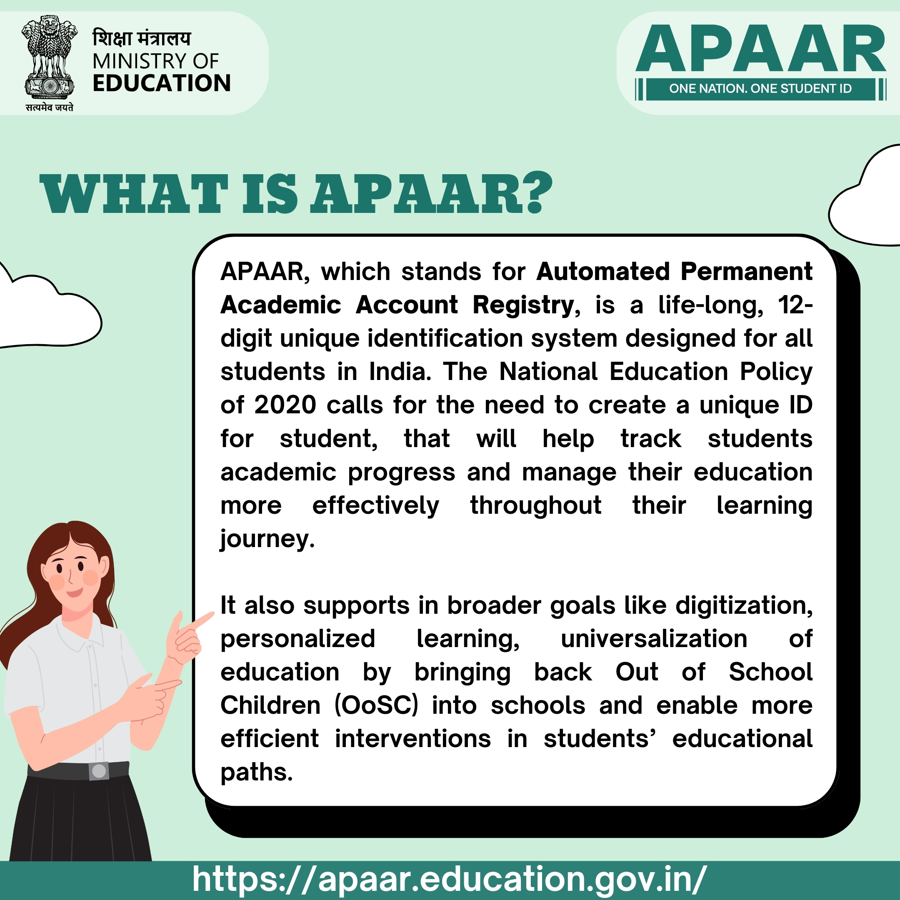

APAAR – Implementation Tool Kit
MORE RESOURCES ARE AVAILABLE AT:
APAAR ID CREATION PROCESS
FAQs for APAAR
Scan here to access APAAR Resources (Multi-lingual)
Or
Visit: https://apaar.education.gov.in/resource
ABOUT APAAR
COMMON MISCONCEPTIONS ABOUT APAAR

Slide 11
Automated Permanent Academic Account Registry (APAAR) ID
Implementation at Population Scale

